Slide 1
Maximising Material Reuse – Urban mining and designing for deconstruction
Module 6

Slide 2
By the end of this module, you will be able to…
Name the steps involved in completing Pre-Demolition Audits (PDA) using the CIRCuIT template
Learn ways to integrate PDA use into city policy
Understand the benefits designing for disassembly (DfD) and adaptability
Learn ways to incorporate DfD and adaptability into city policy

Slide 3
Activity: Identifying Drivers

Slide 4
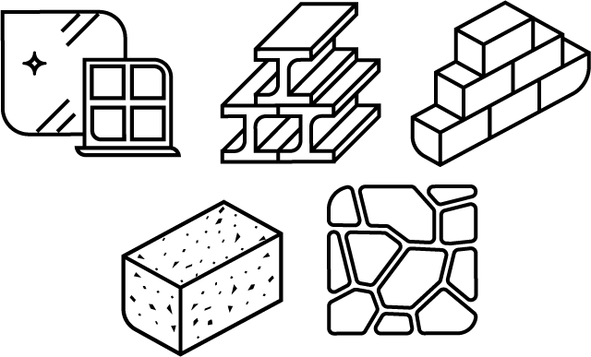
What would drive and/or enable you to either sell or use reused/recycled materials from another project?
Module 6

Slide 5
What is a Pre-demolition Audit (PDA)?
Module 6

Slide 6
How to use a PDA
Module 6

Slide 7
Pre-demolition audit template
Project details
Desk study
Field survey
Inventory of hazardous elements
Inventory of non-hazardous non reusable elements
Inventory of non-hazardous reusable elements

Slide 8
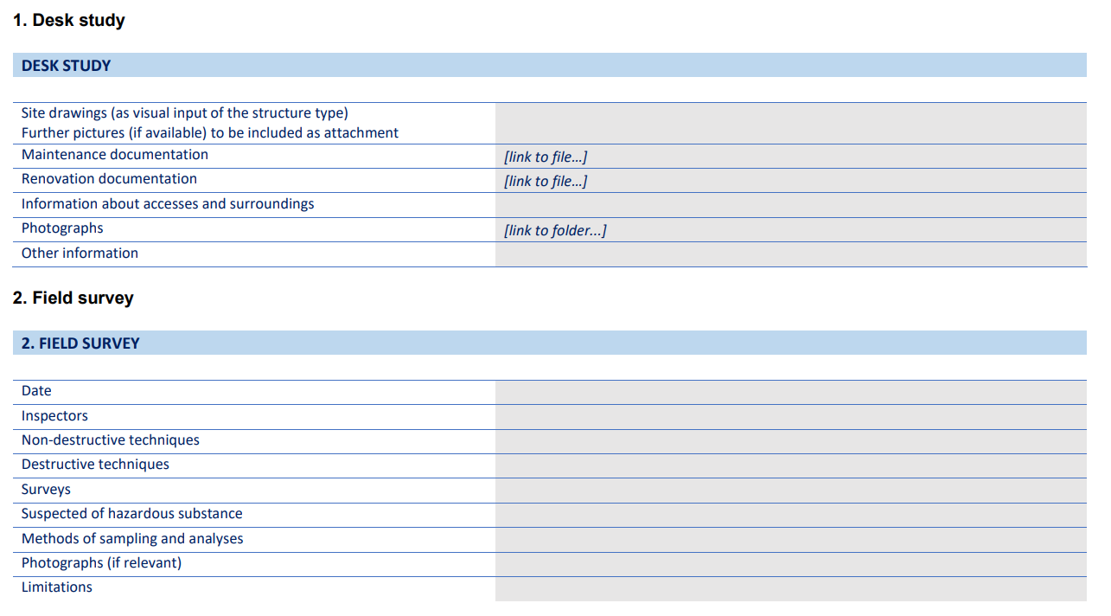
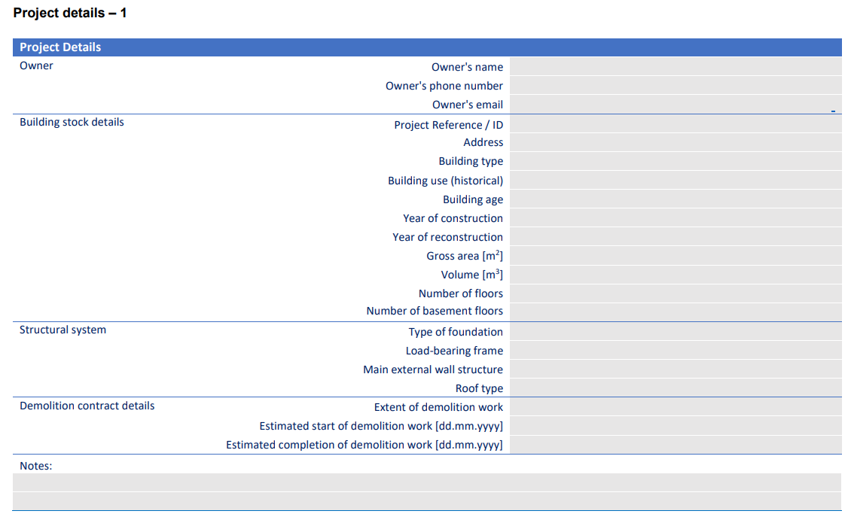
CIRCuIT PDA template
Module 6

Slide 9
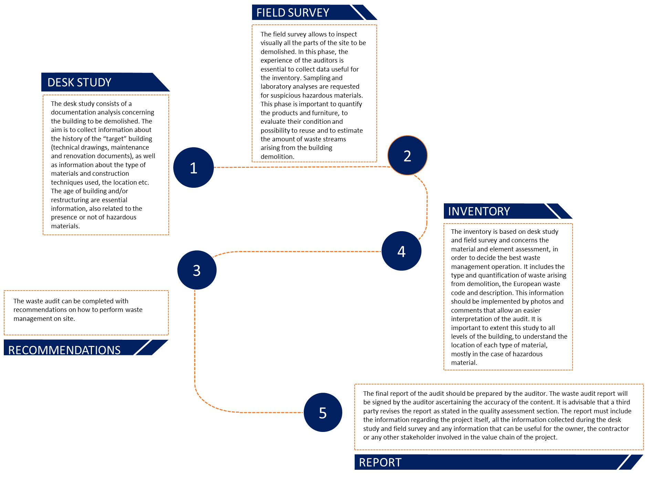
PDA process used by CIRCuIT
Module 6

Slide 10
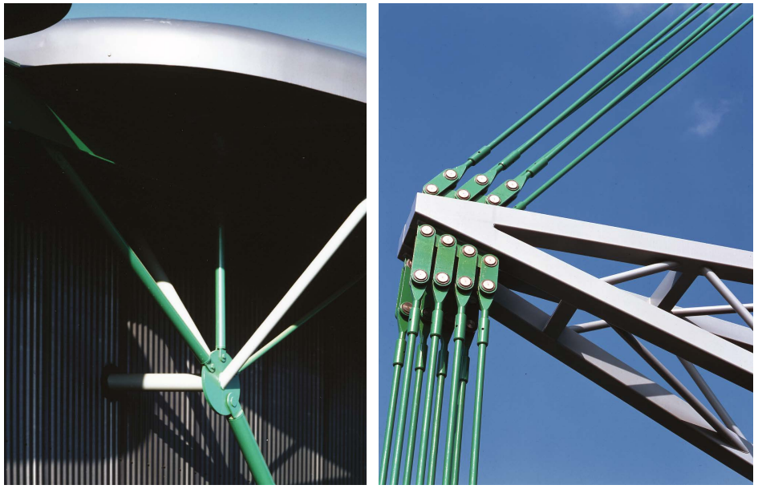
Demolition of Homebase Brentford

Slide 11
Demolition of One Leadenhall Street

Slide 12
How to:
Implement a PDA
How?
Who?
What?

Slide 13
Who should carry out a PDA?
Module 6

Slide 14
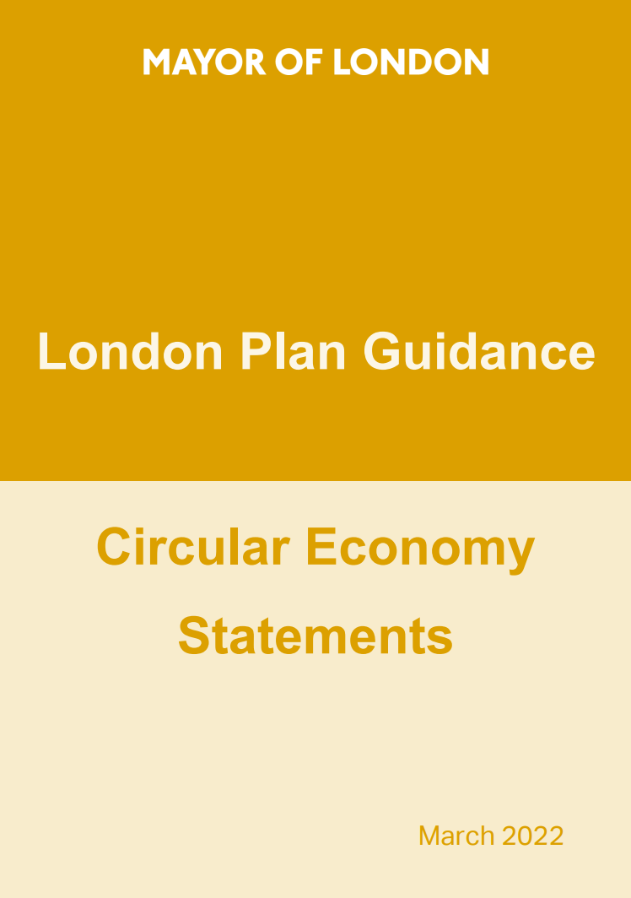
How can we embed the PDA into local policy?
Module 6

Slide 15
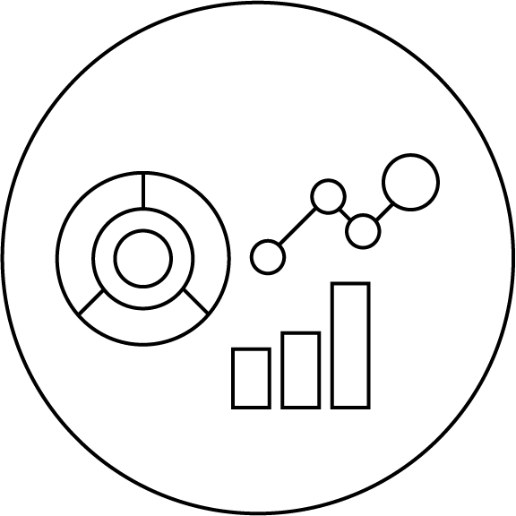
What should we do with the data from a PDA?
Module 6

Slide 16
Checking back in with hierarchy…
Build nothing
Build for long term value
Build efficiently
Build with the right materials

Slide 17
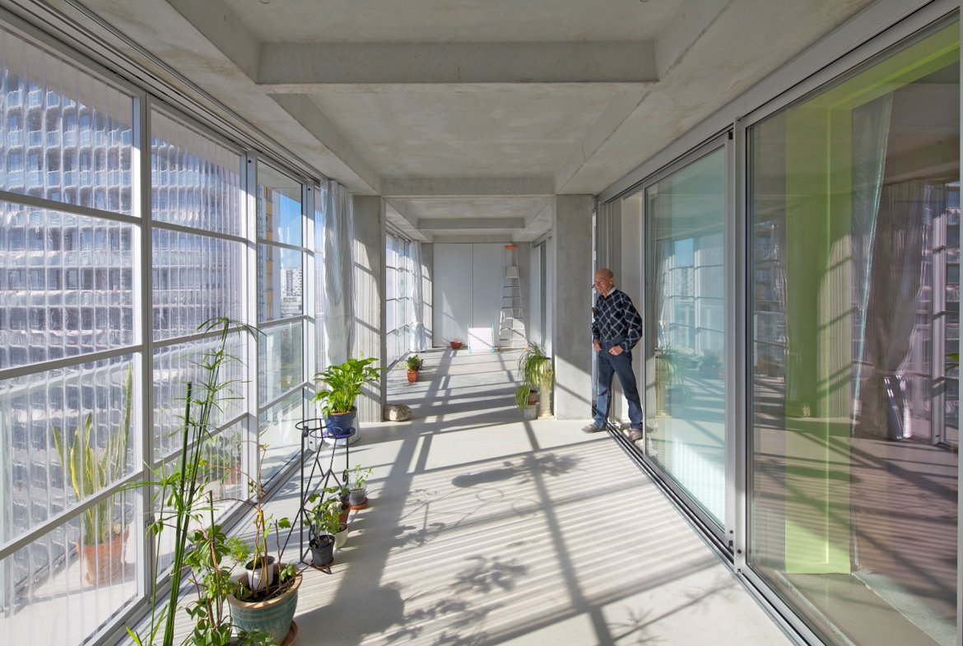
Break
Back in 15 minutes!

Slide 18
Designing for disassembly and adaptability
Module 6

Slide 19
"An approach to the design of a product or constructed asset that facilitates disassembly at the end of its useful life, in such a way that enables components, [ed. materials] and parts to be reused, recycled, recovered for energy or, in some other way, diverted from the waste stream.” (ISO 20887:2020, 2020)

Slide 20
Best practice
examples

Slide 21
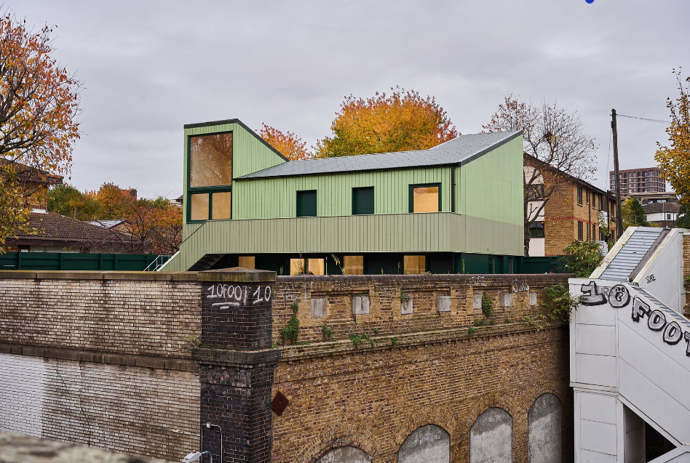
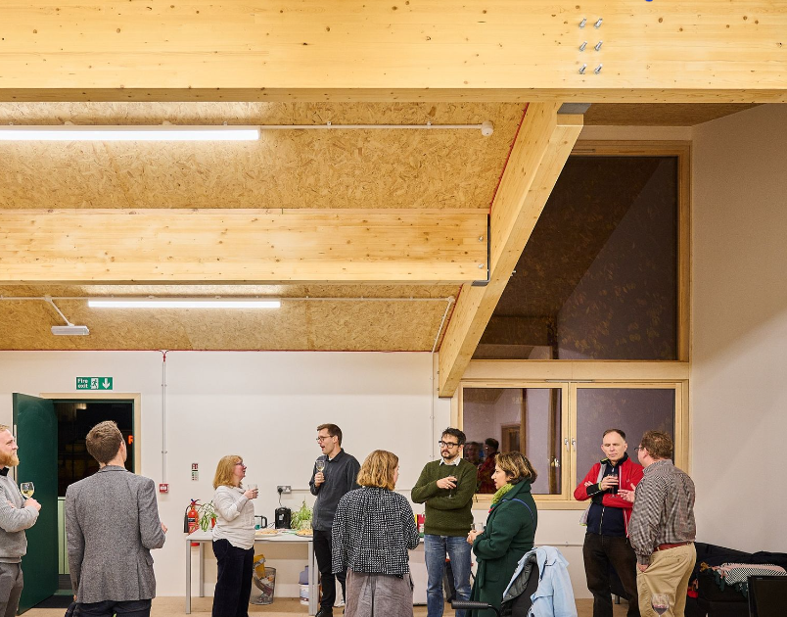
The Hithe, Albion Street

Slide 22
Design for Disassembly Warehouse – Espoo
Figure 1
Baseline structure
Figure 2
Final developed structure
Figure 3
Rigid column-beam connection and joint of tubular beam to column
Module 6

Slide 23
Rightsizer
Module 6

Slide 24
Barriers

Slide 25
Barriers
Assumptions of increased costs
Lack of economic incentives
Insufficient know-how in industry
Unclear risk management
Lack of circular resource portals
Lack of market ready solutions
Barriers
Module 6

Slide 26
Key Opportunities

Slide 27
Key opportunities
Develop pilots and demonstrations
Clarify circular policies and guidance
Development circular construction standards
Progressive economic regulation
Incentivise EOL resource management
Invest in education and know-how
Build business cases
Module 6

Slide 28
Wrap up
Which design interventions are best suited to your cities needs?
Which intervention are you able to champion in your role?
What is the next step or the key missing piece of information you need to take the next step?
Module 6

Slide 29
Questions?

Slide 30
Thank you!
Module 6

Slide 31
Further modules
Module 1:
Building Circular Cities: An introduction to the circular economy in the built environment
Module 2:
Public Procurement for a Circular Built Environment
Module 3: Planning & Policy Drivers for a Circular Built Environment
Module 4:
Building a circular built environment with data
Module 5:
Building Transformation Strategies
Module 2

